Slide 1
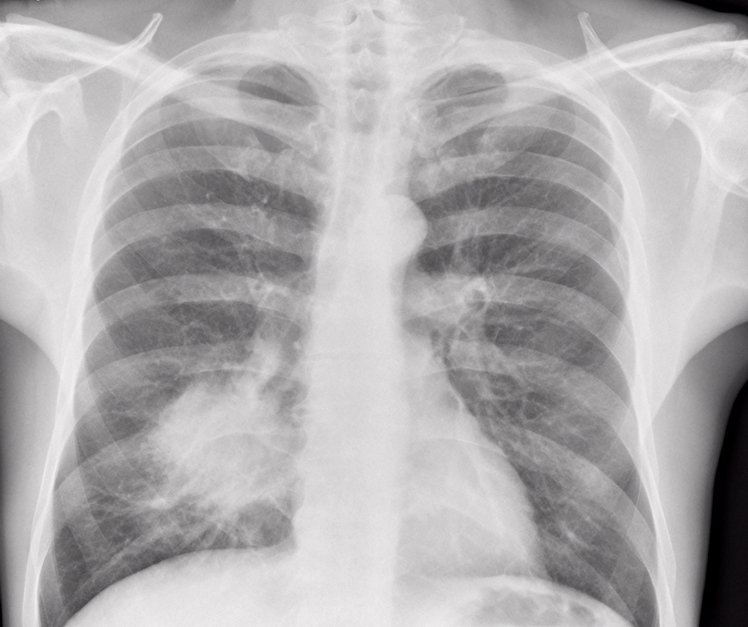
Lung Cancer
ST1(4483) Capstone Project
2023
U3241507 Myeisha Jing Lin Foo

Slide 2
Table of contents
(00)
Questions
(01)
EDA
(02)
PDA
(03)
Deployment
5 questions exploring the dataset
Exploratory Data Analysis and Visualization
Predictive Analytics
Streamlit

Slide 3
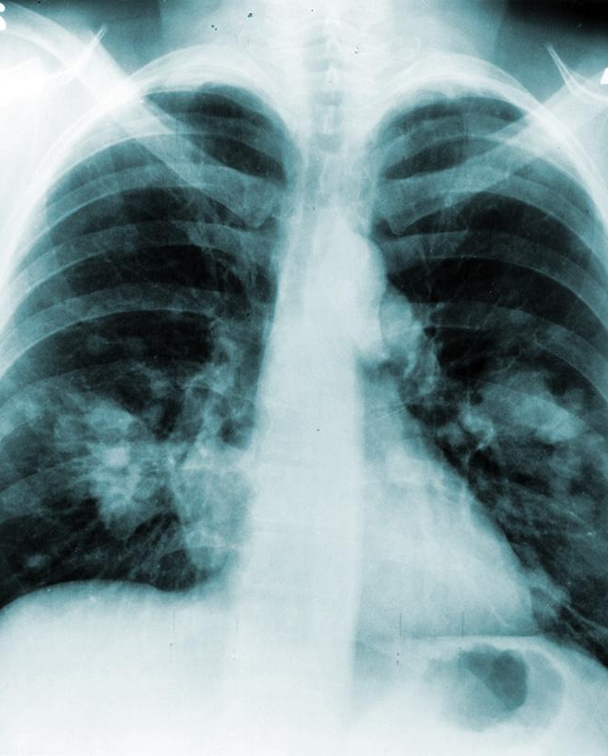
Questions
1. What is the distribution of lung cancer cases in the dataset?
2. How does age relate to the likelihood of lung cancer?
3. Are there any significant correlations between smoking and other attributes with the presence of lung cancer?
4. What are the most common symptoms and conditions associated with lung cancer?
5. Does Gender have correlation to lung cancer?
2023

Slide 4
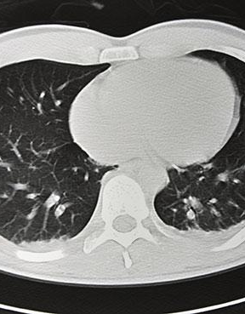
(01)
EDA
2022
Exploratory Data Analysis

Slide 5
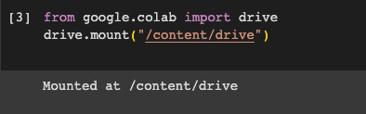
Start
Import
Dataset Retrieval
The following are the code snippets for dataset retrieval:
Preparing the environment to interact with Google Drive in Google Colab
2023
To read the CSV (Comma-Separated Values) file named "surveylungcancer.csv" from a specific file path (My Drive)

Slide 6
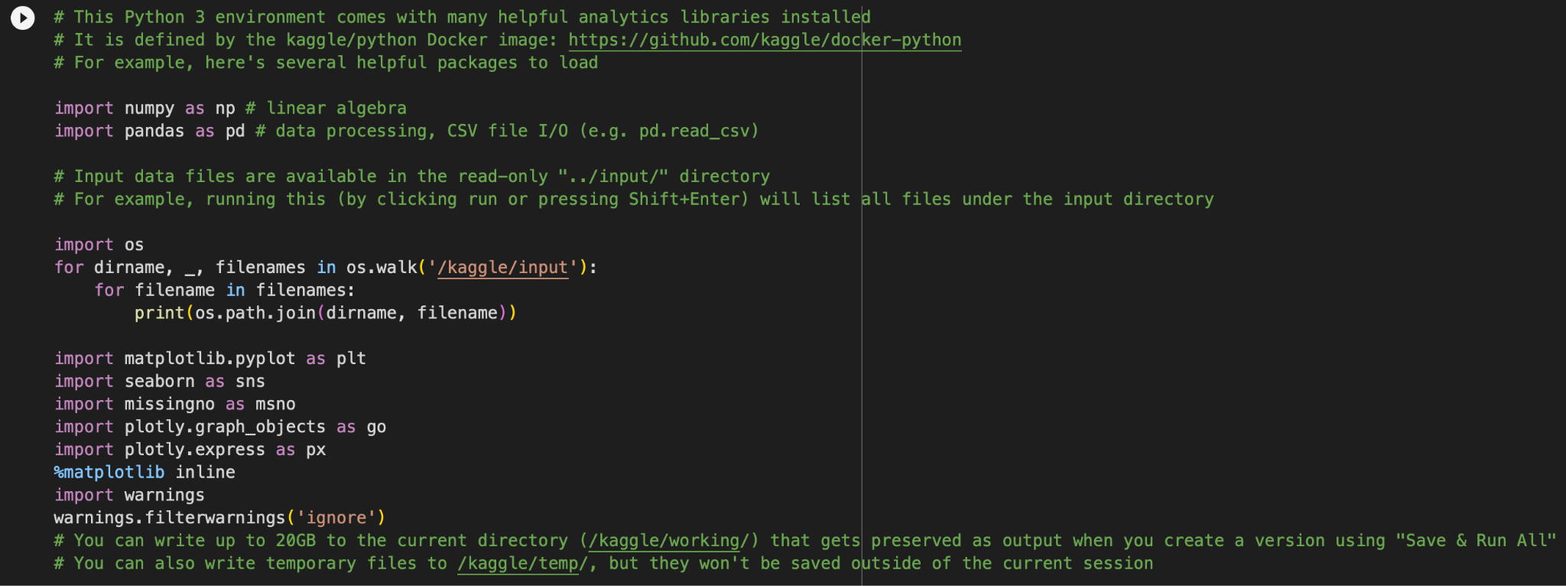
Libraries
These are the libraries that are needed for my EDA.
2023

Slide 7
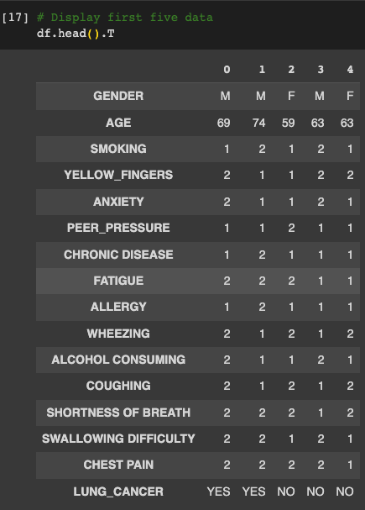
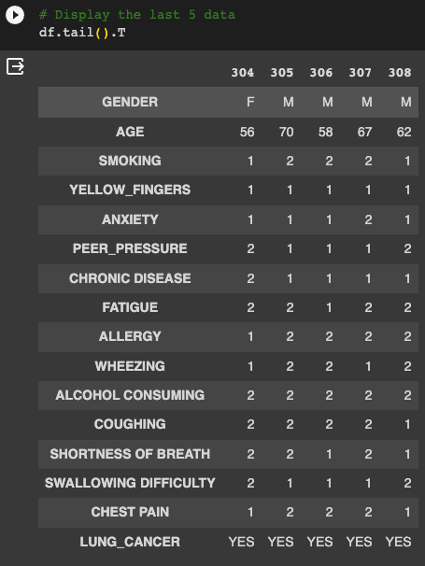
Head & Tail
2023
This displays the first 5 data description (Head) & the last 5 (Tails)

Slide 8
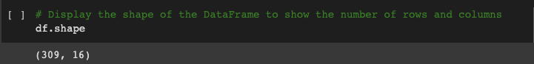
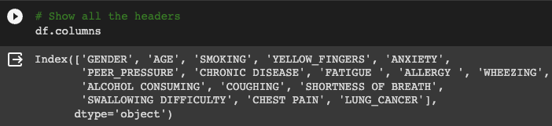
Shape of the DataFrame
Headers
To determine and display the dimensions of the df, showing the number of rows and columns it contains. This provides an overview of the dataset's size.
2023
To retrieve and display the column headers (or feature names) of the df. This step helps to identify the variables or attributes in the dataset.

Slide 9
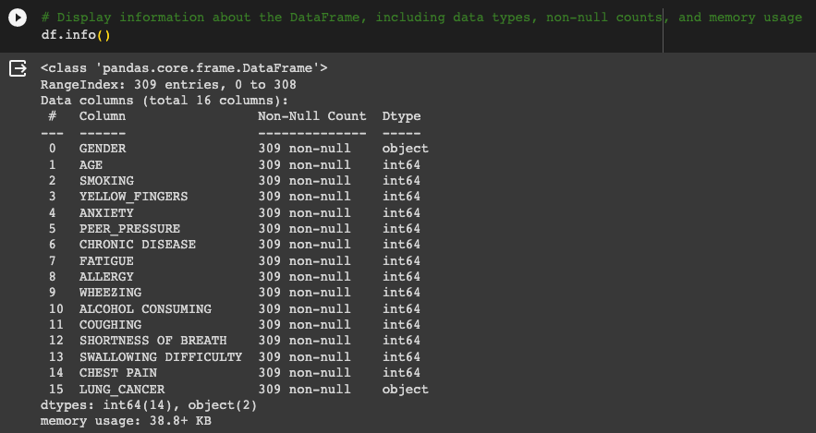
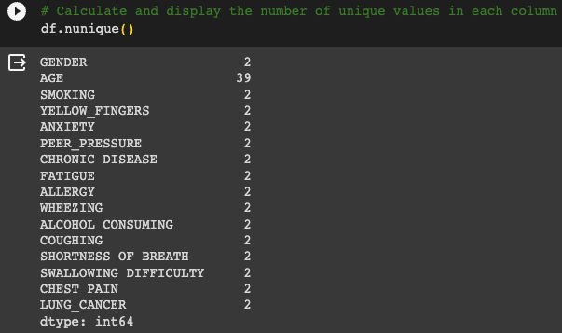
Unique value
& Information
Information
Unique values
2023
To provide comprehensive information about the df, including the data types of each column, the number of non-null (non-missing) values, and the memory usage. This summary is helpful for understanding the structure and content of the dataset
To determine and display the count of unique values in each column of the df. This provides insights into the diversity of values in each feature or attribute.

Slide 10
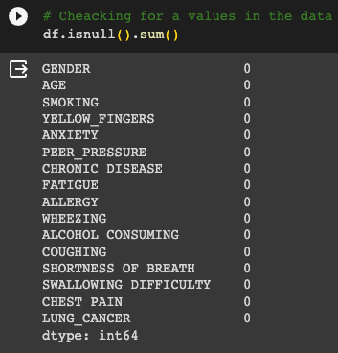
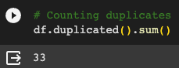
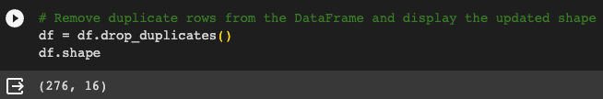
Duplicate & Checking
Duplicate
Checking
2023
To count and display the number of duplicate rows in the df & to remove duplicate rows from the df and then display the updated shape of the DataFrame, showing the number of rows and columns after removing duplicates.
To examine the df for missing (null) values in each column and calculate the sum of missing values in each column.

Slide 11
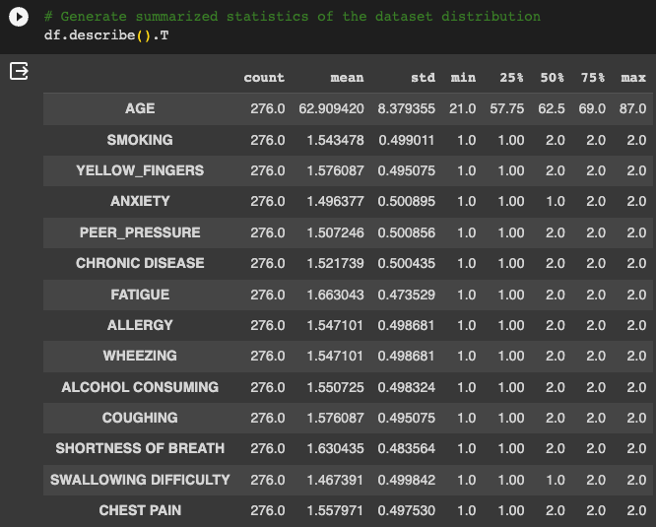
Summarized statistics
To generate and display summary statistics of the dataset's distribution.
The describe() method provides statistics such as count, mean, standard deviation, minimum, and maximum for each numerical column in the df.
Transposing the result with .T makes it easier to read when there are many columns.
2023

Slide 12
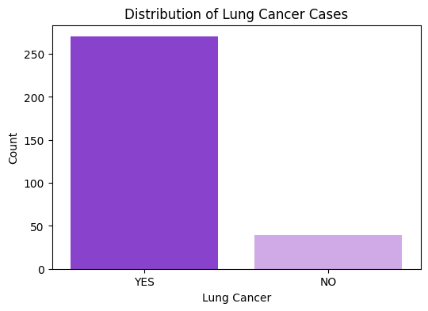
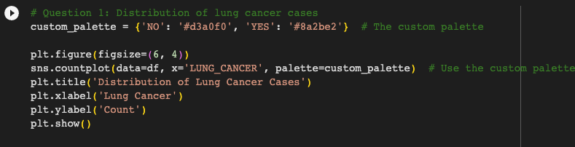
1. What is the distribution of lung cancer cases in the dataset?
Finding
2023
In the dataset there are more people with lung cancer than without

Slide 13
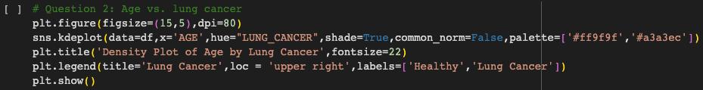
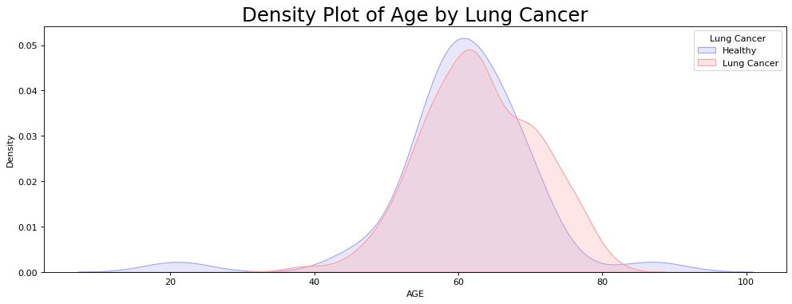
2. How does age relate to
the likelihood of lung cancer?
Finding
People who are typically in the age 20 range tend to have healthy lungs.
The age ranges between 30 to 90 it can vary whether you have a healthy or unhealthy lungs.

Slide 14
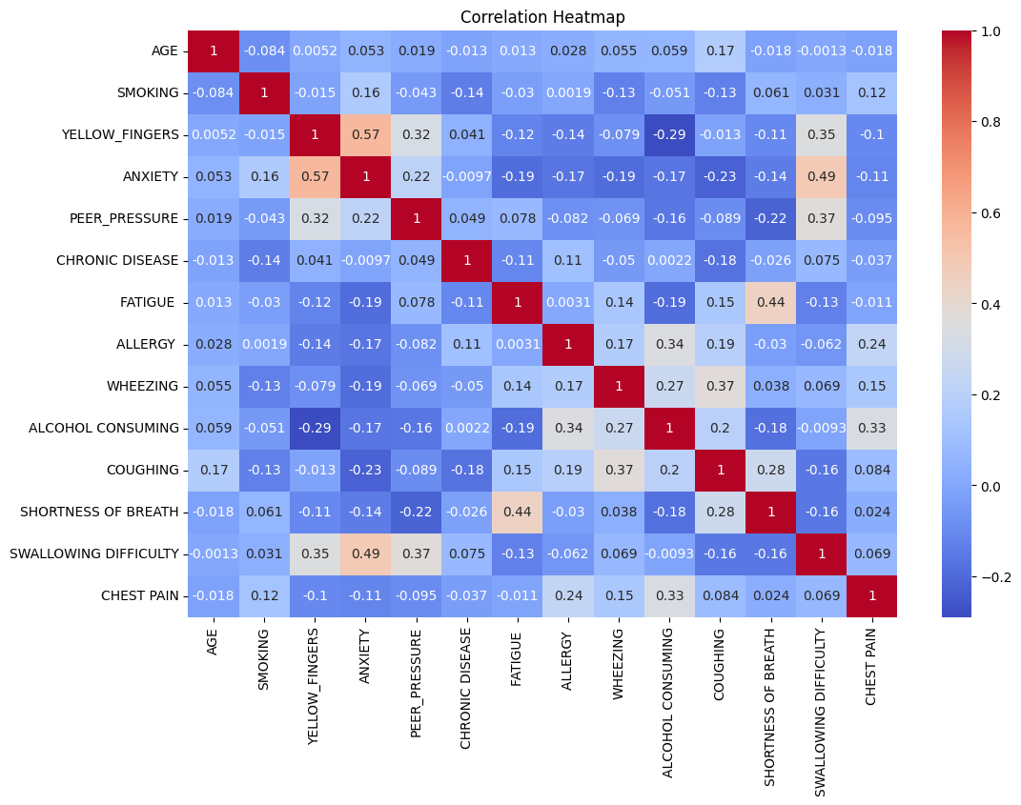
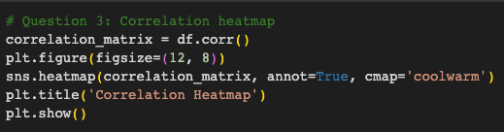
3. Are there any significant correlations between smoking and other attributes with the presence of lung cancer?
Finding
2023
According to the heat correlation map majourity of the symptons and conditions have no correlation to one another.
With the exception of Anxiety and Yellow fingers.

Slide 15
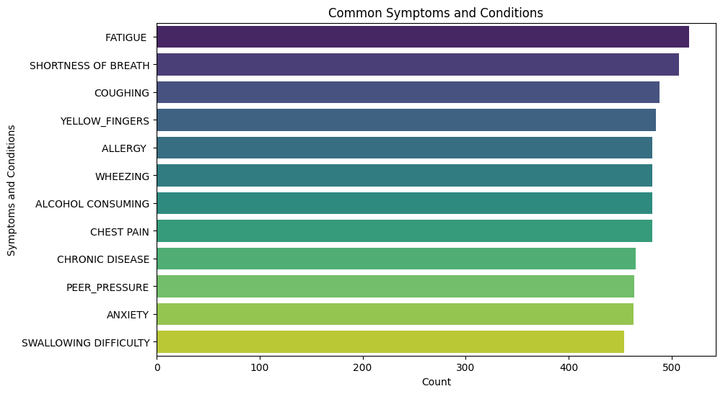
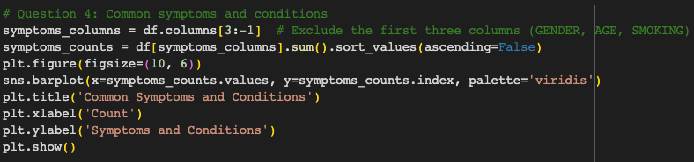
4. What are the most common symptoms and conditions associated with lung cancer?
Finding
2023
The most common symptom and condition is Fatigue , Shortness Of Breath and Coughing.
The least common symptom and condition is Peer Pressure , Anxiety and Swallowing Difficulty.

Slide 16
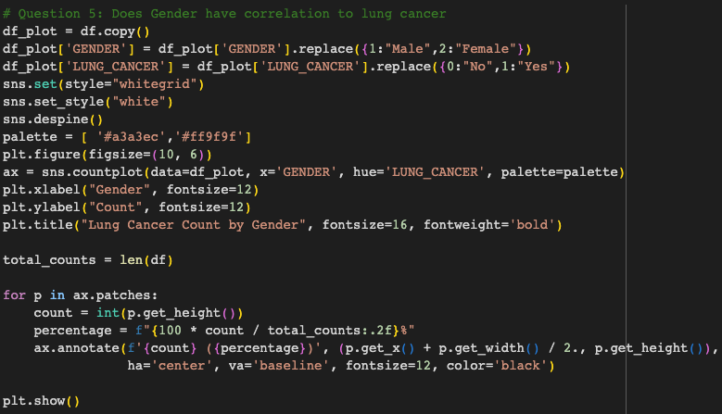
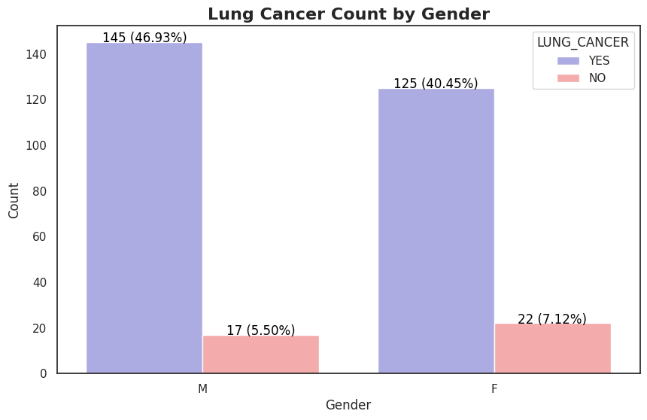
5. Does Gender have correlation to lung cancer
Finding
2023
Gender does not have correlation to having or not having lung cancer
It shows 46.93% of men have lung cancer and 40.45% of women have lung cancer, having a 6.48% difference.
It shows 5.50% of men do not have lung cancer and 7.12% of women do not have lung cancer, having a 2.48% difference.

Slide 17
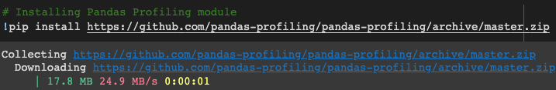
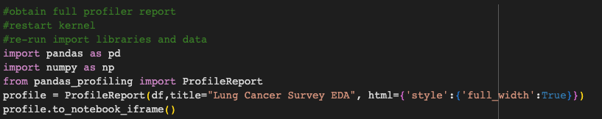
Pandas
Install the Pandas Profiling module
Generates a full profiler report using the Pandas Profiling library
2023

Slide 18
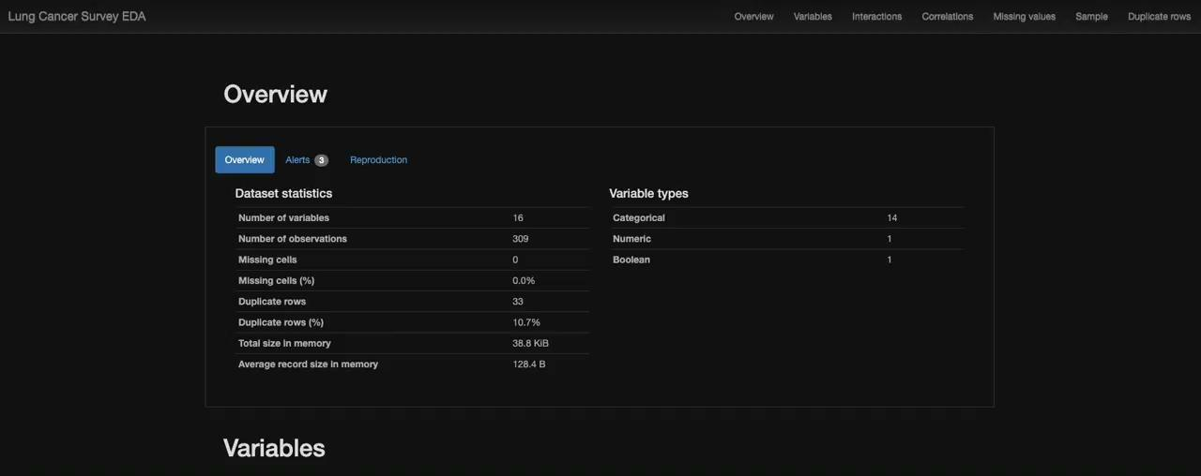
Profiler Report
Here is the generated profile report
2023

Slide 19
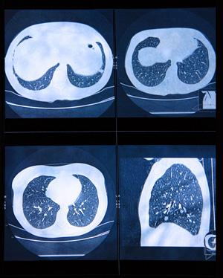
(02)
PDA
2022
Predictive Analysis Task

Slide 20
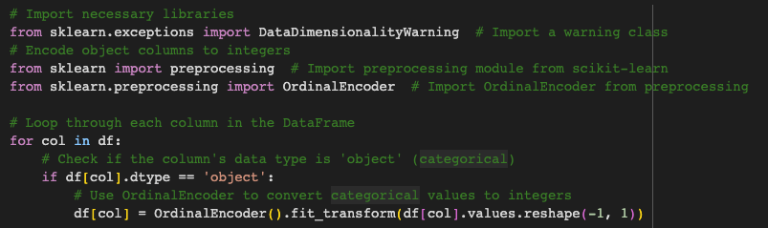
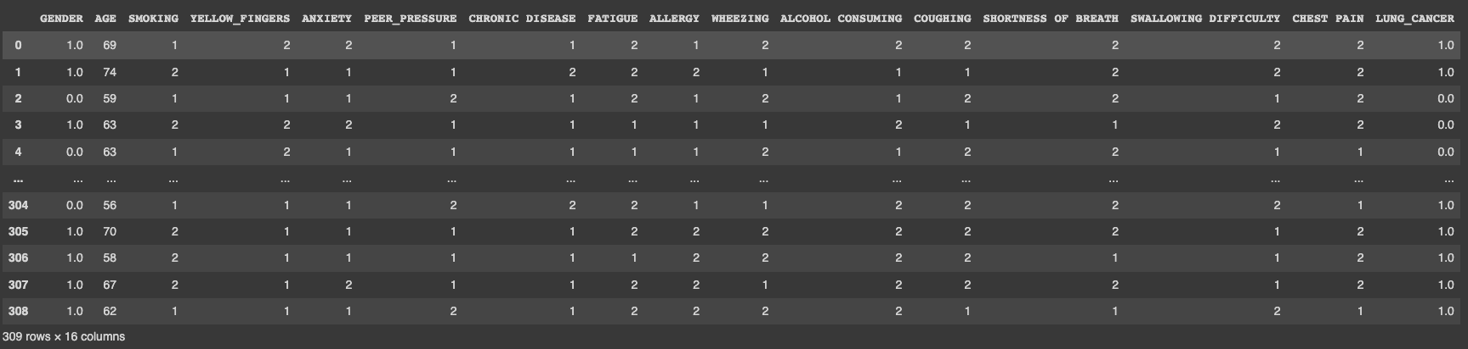
Import
Preprocess a DataFrame by converting categorical (object) values into numerical representations
Required for machine learning algorithms to work with categorical data, as many algorithms expect numerical input
2023

Slide 21
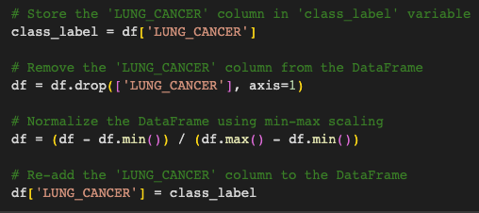
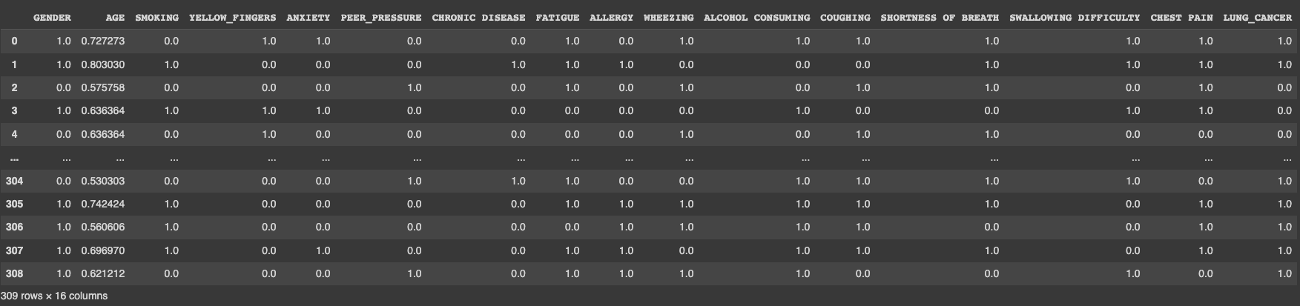
Min-Max
It separates the target variable, scales the feature variables using min-max scaling, and then combines the target variable back with the scaled features to prepare the data for modeling
2023

Slide 22
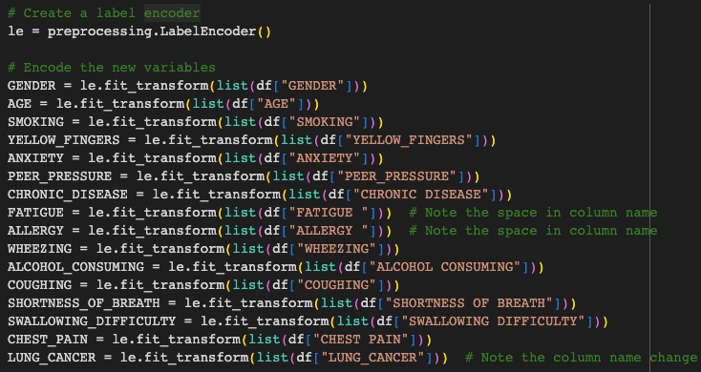
Label
2023
The purpose of this label encoding is to prepare the categorical variables for use in machine learning algorithms Many machine learning models require numerical inputs, and label encoding is one way to achieve this

Slide 23
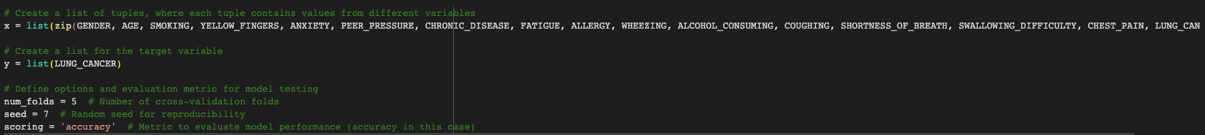
List
Creating a List of Tuples x = list(zip These tuples are used as the feature variables for a machine learning model.
The combination of these variables as features allows the model to learn patterns and relationships in the data to make predictions
Defining Options and Evaluation Metric
num_folds = 5: This sets the number of cross-validation folds Cross-validation is a technique used to assess the model's performance
2023
Creating a List for the Target Variable y = list
The target variable represents what you want to predict or classify using the machine learning model
seed = 7: This defines a random seed, which is used to control the randomization process during cross-validation and other random operations
scoring = 'accuracy': This specifies the evaluation metric to measure the model's performance
assess the model's accuracy in making predictions

Slide 24
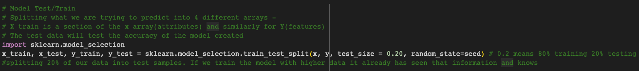
Splitting
2023
The purpose of splitting the data into training and testing sets is to evaluate how well the machine learning model generalizes to unseen data.
This helps avoid issues like overfitting, where a model memorizes the training data but performs poorly on new data

Slide 25
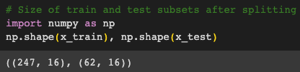
Size
2023
The purpose of calculating and printing the shapes of these subsets is to help you verify that the data splitting process has occurred as intended

Slide 26
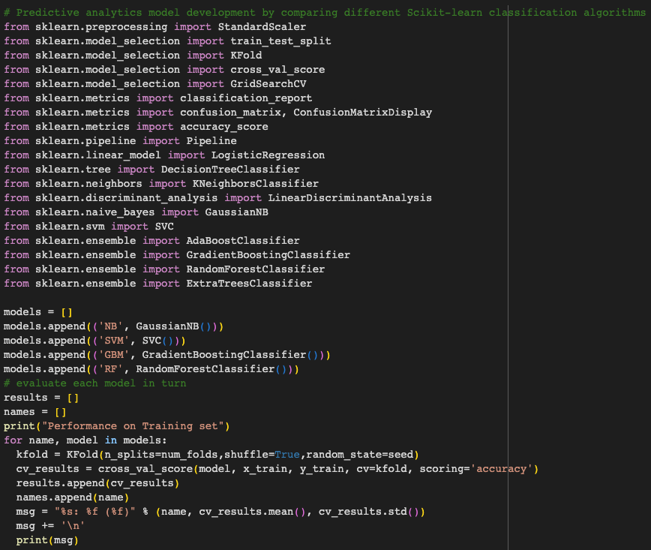
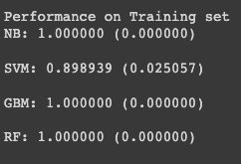
Performance
Compare the performance of different classification algorithms on the training set
NB: Gaussian Naive Bayes
SVM: Support Vector Machine
GBM: Gradient Boosting
RF: Random Forest
2023

Slide 27
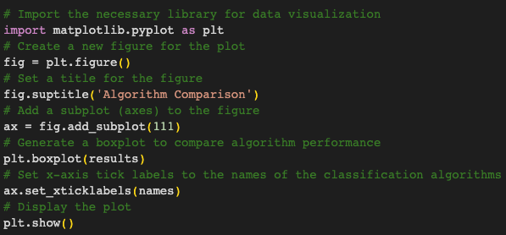
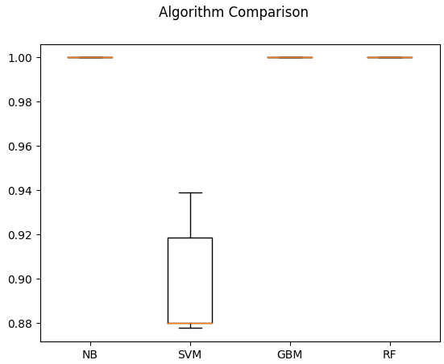
Visual Comparison
2023
Provide a visual comparison of the performance of different machine learning algorithms on the training data

Slide 28
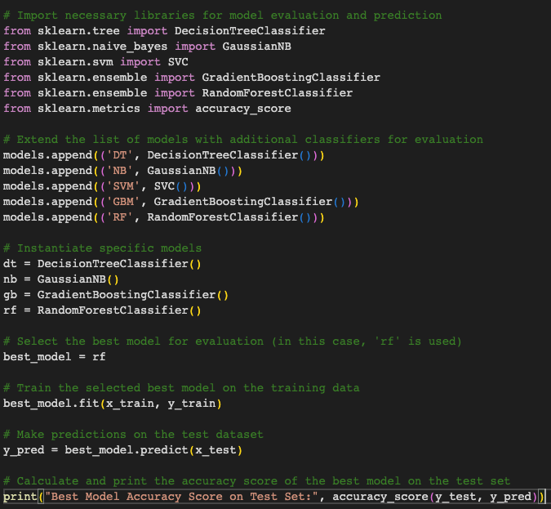
Best Model
Assess the performance of different classification models on an independent test dataset and determine which model achieves the highest accuracy on the test data.
NB: Gaussian Naive Bayes
SVM: Support Vector Machine
GBM: Gradient Boosting
RF: Random Forest
2023

Slide 29
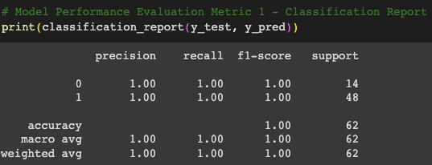
Classification
2023
A detailed summary of the model's performance on the test dataset in a classification task classification report is a valuable tool for understanding how well a model performs on individual classes within a multi-class classification problem

Slide 30
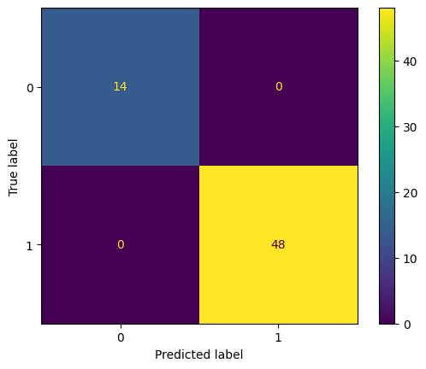
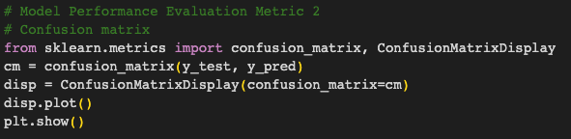
Confusion matrix
2023
Visualize and evaluate the model's performance using a confusion matrix Comprehensive view of how well the model performs in terms of correct and incorrect predictions for each class

Slide 31
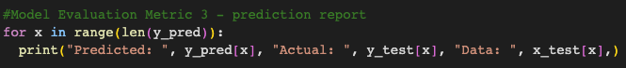
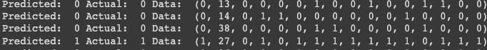
Prediction Report
2023
prediction report, where it displays the predicted values, actual values, and the corresponding data for each instance in the test dataset. manual inspection of the model's predictions and how they compare to the actual values in the test datase

Slide 32
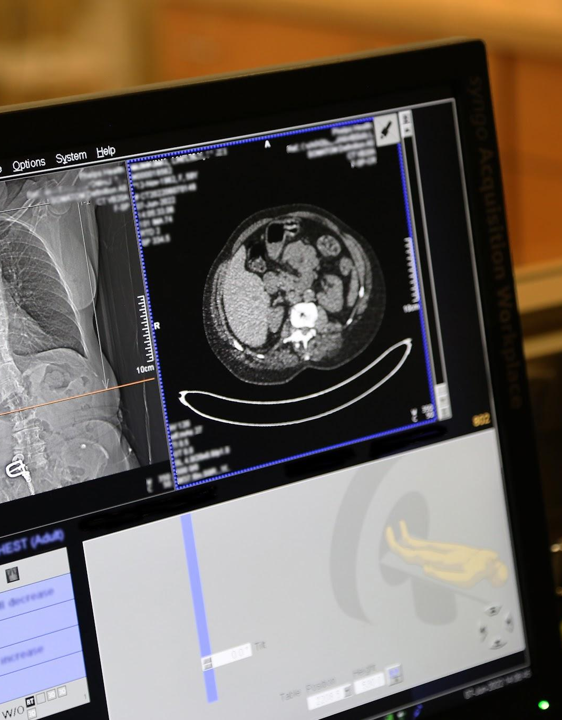
(03)
Deployment
2022
Implementation & Deployment

Slide 33
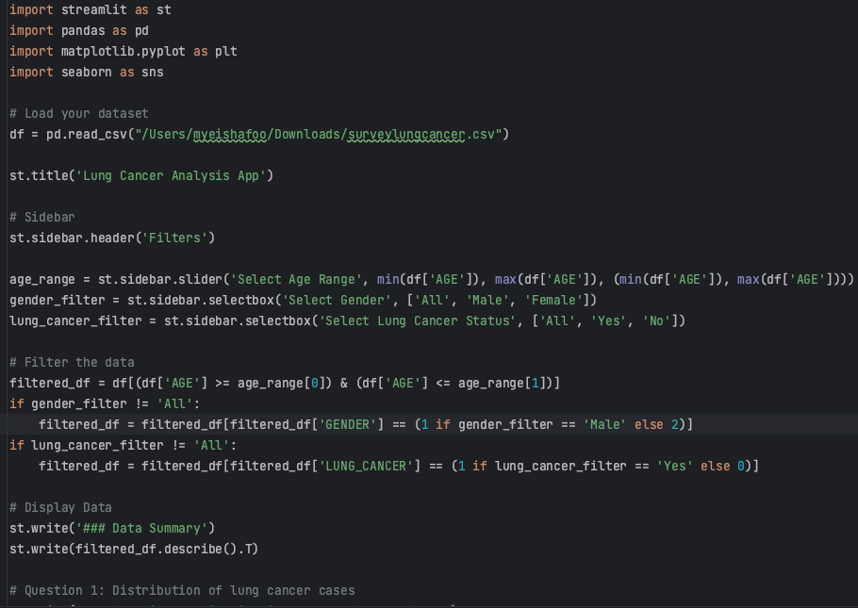
Install
& Run
Streamlit web application that performs data analysis and visualization for lung cancer-related data
2023

Slide 34
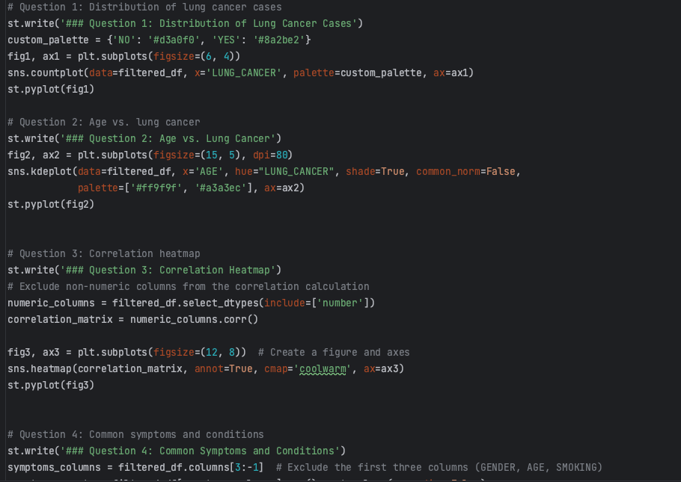

Questions
Create an interactive web application that allows users to explore and analyze lung cancer-related data with various visualization and data filtering options.
2023

Slide 35

Streamlit
Lung Cancer
Analysis App
Streamlit web application that performs data analysis and visualization for lung cancer-related data
2023

Slide 36


Thanks
ST1(4483) Capstone Project
Do you have any questions?
References:
MySarahMadBhat. (2021). Lung Cancer Dataset. Kaggle. URL: https://www.kaggle.com/datasets/mysarahmadbhat/lung-cancer. Accessed: [12 October 2023]
Pandas Development Team. (2023). Pandas DataFrame Documentation. pandas.pydata.org. URL: https://pandas.pydata.org/docs/reference/api/pandas.DataFrame.html. Accessed: [1 October 2023]
Streamlit. (2023). st.dataframe API Reference. Streamlit Documentation. URL: https://docs.streamlit.io/library/api-reference/data/st.dataframe. Accessed: [2 October 2023].
Indeed. (2023). How to Conduct Exploratory Data Analysis. indeed.com. URL: https://www.indeed.com/career-advice/career-development/how-to-conduct-exploratory-data-analysis. Accessed: [31 September 2023]
2023

